Slide 1
THE REPRODUCTIVE SYSTEM

Slide 2
I. Reproduction
The ability of organisms to produce more of their own kind; necessary for the preservation of the species, not the individual.
Asexual reproduction:
Characteristics:
1. Occurs in simple organisms.
2. Leads to the production of offspring that are genetically identical to the parent (barring mutation) which can be detrimental when environmental conditions change quickly.
3. Allows an organism to rapidly produce many offspring without the time and resources committed to courtship, finding a mate, and mating.

Slide 3
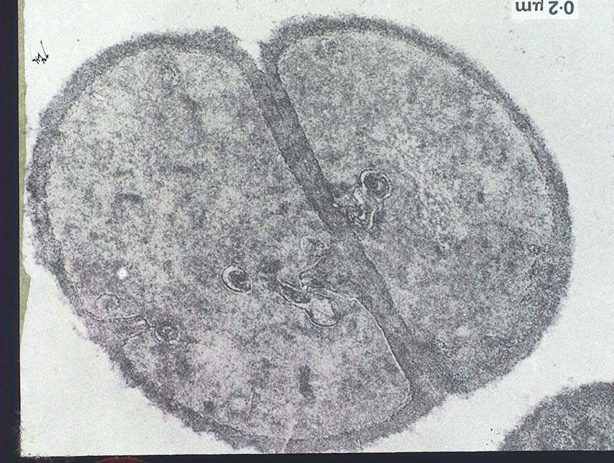
4. Modes of Asexual Reproduction
Binary Fission: Unicellular organisms split into two equal offspring having the same genetic content.
Ex: Monerans, Protists.
Bacteria undergoing binary fission. From www.mds.qmw.ac.uk/.../ images/emgpmit.jpg

Slide 4
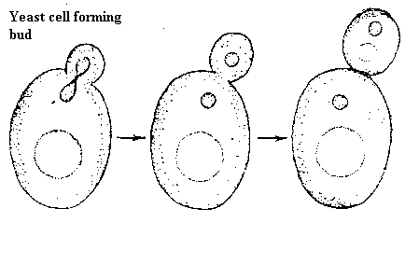
Budding: Unicellular organisms splitting unequally; unequal cytoplasmic division, equal nuclear division.
Ex: Fungus (Yeast)
Yeast cells undergoing the process of Budding. From www.uq.edu.au/_School_Science_Lessons/ Yeast.GIF

Slide 5
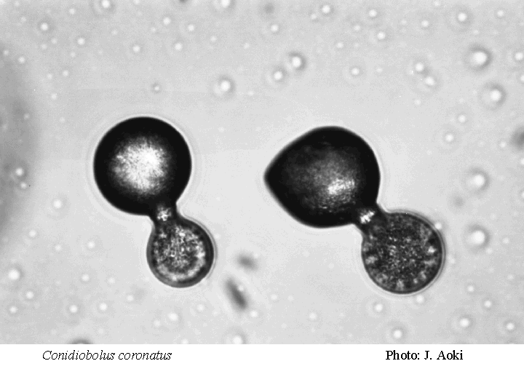
Sporulation:
The production of haploid spores in response to adverse environmental conditions.
Ex: Mold and mushrooms (Fungus) and bacteria (Monerans)
Bacterial spore formation. From fruit.naro.affrc.go.jp/.../ micro/NAJ005.gif

Slide 6
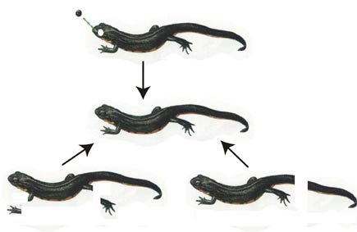
Regeneration : the process in which severed parts of an organisms grow back.
Regeneration in the newt. From gabriel.ess.sci.osaka-u.ac.jp/.../ toku-jp.html
Vegetative Propagation: Asexual reproduction in plants; natural or artificial; Ex: runners, tubers, bulbs, tracheids, grafting, cuttings, etc.

Slide 7
b) Sexual Reproduction
New individuals are produced by the fusion of haploid gametes to form a diploid zygote via fertilization.
Sperm are male gametes, ova (ovum singular) are female gametes.
Meiosis produces gametes that are genetically distinct from each other.
Sexual Reproduction leads to increased variation on which natural selection can operate.

Slide 8
II. Human Reproduction and Development
Human reproduction employs internal fertilization, and depends on the integrated action of hormones, the nervous system, and the reproductive system.
Gonads are sex organs that produce gametes.
Male gonads are the testes, which produce sperm and male sex hormones.
Female gonads are the ovaries, which produce eggs (ova) and female sex hormones.

Slide 9
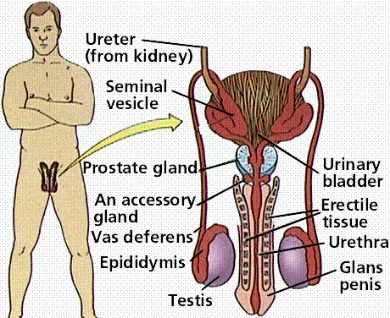
The male reproductive system. Images from Purves et al., Life: The Science of Biology, 4th Edition, by Sinauer Associates (www.sinauer.com) and WH Freeman (www.whfreeman.com), used with permission.

Slide 10
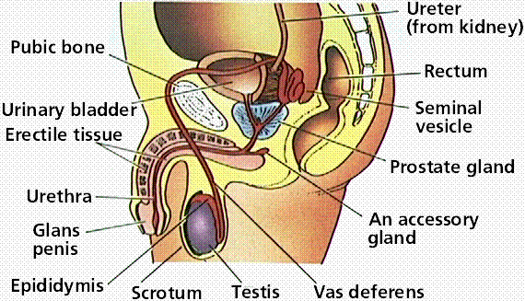
The male reproductive system. Images from Purves et al., Life: The Science of Biology, 4th Edition, by Sinauer Associates (www.sinauer.com) and WH Freeman (www.whfreeman.com), used with permission.

Slide 11
a) The Male Reproductive System
1. Testes are suspended outside the abdominal cavity by the scrotum, a pouch of skin that keeps the testes close or far from the body at an optimal temperature for sperm development.
2. Seminiferous tubules are inside each testis, and are where sperm are produced by meiosis.
Spermatocytes inside the tubules divide by meiosis to produce spermatids that in turn develop into mature sperm.
3. Once sperm form they move into the epididymis, where they mature and are stored.
4. Sperm pass from the epididymis through the vas deferens and connect to a short ejaculatory duct that connects to the urethra.

Slide 12
5. Secretions from the seminal vesicles add fructose and prostaglandins to sperm as they pass.
The prostate gland secretes a milky alkaline fluid.
The bulbourethral gland secretes a mucus-like fluid that provides lubrication for intercourse.
6. Sperm and secretions make up semen.
7. Male Sex Hormones
The anterior pituitary produces follicle-stimulating hormone (FSH) and luteinizing hormone (LH).
Action of LH is controlled by the gonadotropin-releasing hormone (GnRH).
LH stimulates cells in the seminiferous tubules to secrete testosterone, which has a role in sperm production and developing male secondary sex characteristics.
FSH acts on cells to help in sperm maturation. Negative feedback by testosterone controls the actions of GnRH.

Slide 13
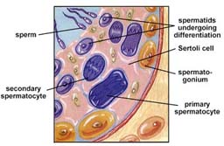
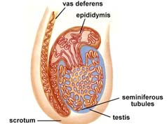
Details of the testes. The above images are from http://www.biosci.uga.edu/almanac/bio_103/notes/apr_4.html.

Slide 14
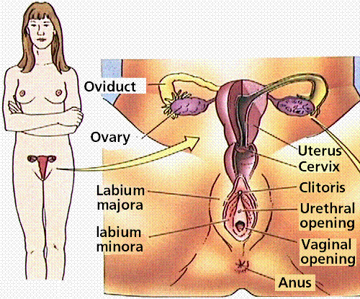
b) The Female Reproductive System
The female gonads, ovaries, are located within the lower abdominal cavity.

Slide 15
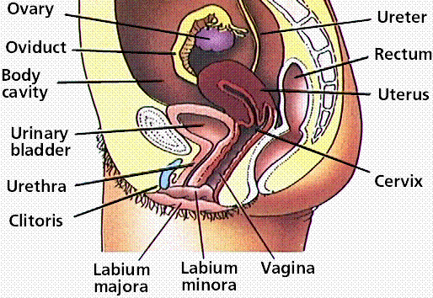

Slide 16
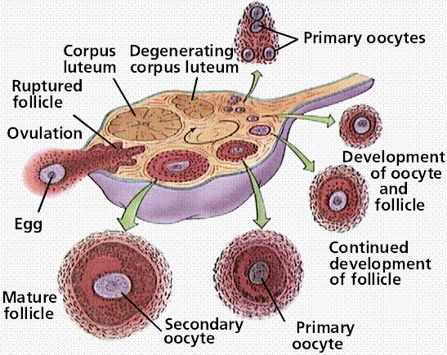
The female reporoductive system. Images from Purves et al., Life: The Science of Biology, 4th Edition, by Sinauer Associates (www.sinauer.com) and WH Freeman (www.whfreeman.com), used with permission.

Slide 17
1. The ovary contains many follicles composed of a developing egg surrounded by an outer layer of follicle cells.
2. Each egg begins oogenesis as a primary oocyte.
At birth each female carries a lifetime supply of developing oocytes, each of which is in Prophase I.
A developing egg (secondary oocyte) is released each month from puberty until menopause, a total of 400-500 eggs.

Slide 18
Ovarian Cycles : The ovarian cycle lasts usually 28 days.
Follicular phase (maturing follicles): The oocyte matures within a follicle. The release of FSH by the anterior pituitary stimulates the oocyte maturation.
Ovulation : The oocyte is released from the ovary and swept into the Fallopian Tubes aka oviducts (site of fertilization). A surge in LH from the anterior pituitary causes the ovarian follicle to burst.
Luteal phase (ruptured ovarian follicle): The corpus luteum synthesizes hormones (estrogen and progesterone) that causes the thickening of the uterine lining for pregnancy.
Menstrual Phase: The endometrium will break down if fertilation does not occur. This coincides with a decrease in the levels of estrogen released by the corpus luteum.

Slide 19
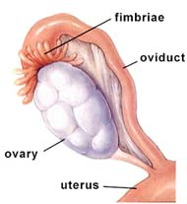
The relationship of ovary andFallopian tube. The above image is from http://www.biosci.uga.edu/almanac/bio_103/notes/apr_8.html

Slide 20
The uterus has an inner layer, the endometrium, in which a fertilized egg implants. At the lower end of the uterus the cervix connects the uterus to the vagina.
The vagina acts as the site of intercourse and serves as the birth canal.

Slide 21
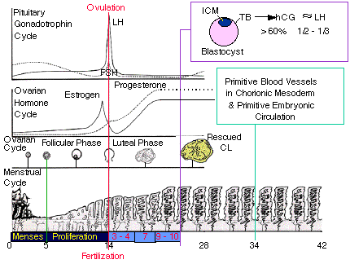
Hormonal Changes of the Menstrual Cycle. Note that increased concentrations of estrogen and progesterone cause the endometrium to thicken. FSH causes the swelling of the ovarian follice which is accompanied by the maturation of the ova. A surge in LH causes ovulation. From: http://www.grad.ttuhsc.edu/courses/histo/notes/female.html

Slide 22
III. Human Fertilization and Development
Steps in Fertilization
Contact between sperm and egg
Entry of sperm into the egg
Fusion of egg and sperm nuclei
Activation of development
a) Cleavage
Cleavage is the first step in development of ALL multicelled organisms.
Cleavage converts a single-celled zygote into a multicelled embryo by mitosis. The end of cleavage is characterized by a solid ball of cells known as a morula.
The blastula is produced by mitosis of the zygote, and is a ball of cells surrounding a fluid-filled cavity (the blastocoel).

Slide 23
Gastrulation
Gastrulation involves a series of cell migrations to positions where they will form the three primary cell layers.
Ectoderm forms the outer layer which develops into the skin and nervous systems.
Endoderm forms the inner layer which develops into the digestive and respiratory systems.
Mesoderm forms the middle layer which develops into body muscles, cartilage, bone, blood, connective tissues, reproductive system organs and kidneys.

Slide 24
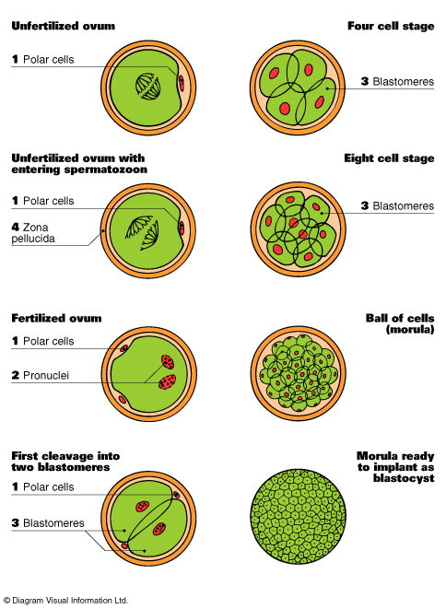
Early embryonic development – Cleavage
From: http://www.fofweb.com/Electronic_Images/onfiles/SciHumAnat9-22c.gif

Slide 25
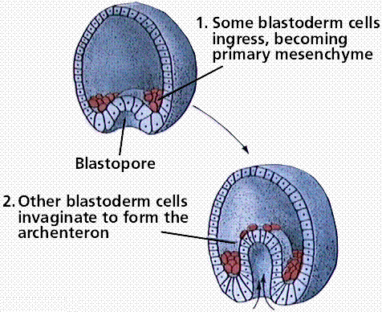

Slide 26
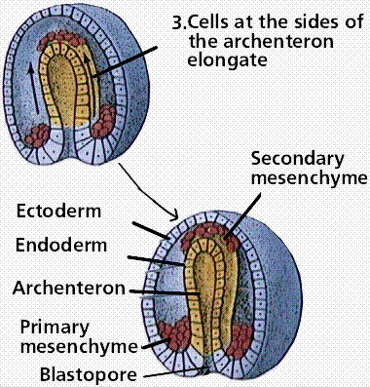
Gastrulation. Images from Purves et al., Life: The Science of Biology, 4th Edition, by Sinauer Associates (www.sinauer.com) and WH Freeman (www.whfreeman.com), used with permission.

Slide 27
IV. Extraembryonic Membranes
The embryos of reptiles, birds, and mammals produce 4 extraembryonic membranes:
  amnion
  yolk sac
  chorion
  allantois
a) Birds and Reptiles: (amniotes) embryos with its extraembryonic membranes develops within a shelled egg. Fertilization is internal while development is external in a terrestrial environment.
Amnion protects the embryo in a sac filled with amniotic fluid.
Yolk sac contains yolk — the sole source of food until hatching. Yolk is a mixture of proteins and lipoproteins.
Chorion lines the inner surface of the shell (which is permeable to gases) and participates in the exchange of O2 and CO2 between the embryo and the outside air.
4. Allantois stores metabolic wastes (uric acid) of the embryo and, as it grows larger; also participates in gas exchange.

Slide 28
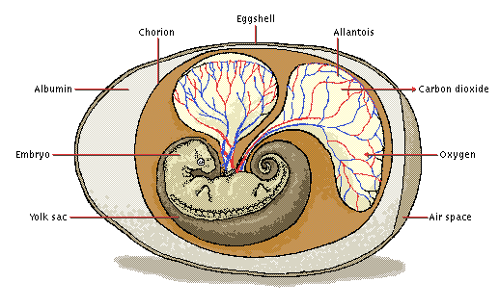
Amniotic Egg From : http://images.encarta.msn.com/xrefmedia/aencmed/targets/illus/ilt/T013908A.gif

Slide 29
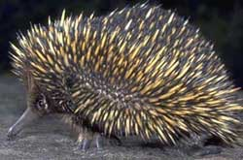
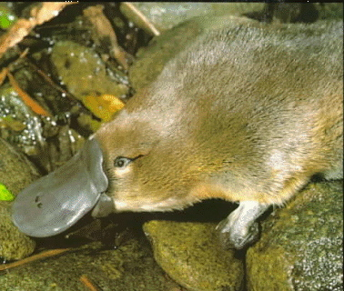
b) Mammals
1. Monotremes
primitive mammals produce a shelled egg like their reptilian ancestors; three species exist today: two species of spiny anteater (echidna) and the duckbill platypus.
Duckbill platypus From: http://www.auburn.edu/academic/classes/zy/0301/Topic3e/platypus
Spiny Anteater From: http://www.ezsoftech.com/ramadan/fasting_animals.asp

Slide 30
2. Marsupials
Marsupials do not produce a shelled egg. The egg, which is poorly supplied with yolk, is retained for a time within the reproductive tract of the mother. The embryo penetrates the wall of the uterus. The yolk sac provides a rudimentary connection to the mother's blood supply from which it receives food, oxygen, and other essentials. However, this interface between the tissues of the uterus and the extraembryonic membranes never becomes elaborately developed, and the young are born in a very immature state.
Despite their tiny size, they are able to crawl into a pouch on the mother's abdomen, attach themselves to nipples, and drink milk from her mammary glands.
Marsupials are still abundant in Australia, but only the opossum is found in North America.

Slide 31

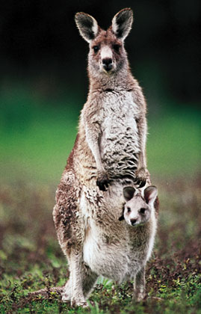
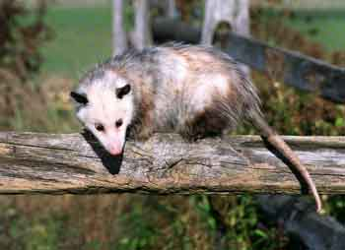
Marsupials From:http://w3.dwm.ks.edu.tw/bio/activelearner/30/images/ch30c4.jpg
Opossum
Koala
Kangaroo

Slide 32
Placental mammals
In placental mammals, the extraembryonic membranes form a placenta and umbilical cord, which connect the embryo to the mother's uterus in a more elaborate and efficient way. The blood supply of the developing fetus is continuous with that of the placenta. The placenta extracts food and oxygen from the uterus. Carbon dioxide and other wastes (e.g., urea) are transferred to the mother for disposal by her excretory organs.
Humans are placental mammals.

Slide 33
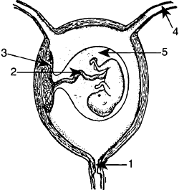
Cervix: opening to the uterus; dilates during childbirth.
Umbilical Cord: contains arteries and veins; connects the fetus/embryo to the mother’s placenta; delivers nutrients to the developing fetus/embryo while removing metabolic wastes.
Placenta: is implanted in the wall of the uterus, where it receives nutrients and oxygen from the mother's blood and passes out waste.
Oviduct (Fallopian Tube): site of fertilization.
Amnion: membranous sac that hold the amniotic fluid which protects the developing fetus/embryo from physical shock.
6. Uterus: muscular and flexible; site of embryonic development.
6

Slide 34
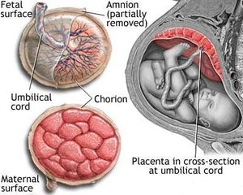
Placenta
From:http://en.wikipedia.org/wiki/Placenta

Slide 35
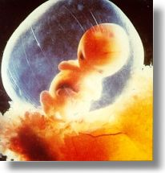

Slide 36
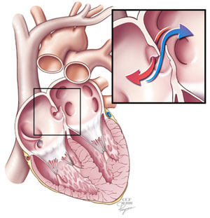
V. Fetal Circulation
a) Foramen ovale is a small hole located in atrial septum that is used during fetal circulation to speed up the travel of blood through the heart.
In the womb,a baby relies on the mother to provide oxygen-rich blood from the placenta through the umbilical cord to the fetus.
Fetal blood is NOT pumped to the lungs for oxygenation.
Blood can travel from the vena cava to the right side of the baby's heart and cross to the left side of the heart through the foramen ovale and skip the trip to the baby's lungs.
Normally the foramen ovale closes at birth when increased blood pressure on the left side of the heart forces the opening to close.

Slide 37
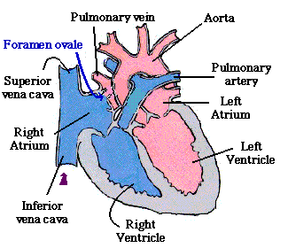

Slide 38
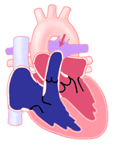
b) Ductus arteriosis is a wide muscular blood vessel joining the pulmonary artery (main artery to the lungs) to the aorta (main artery to the body).
This connection allows blood to be diverted from the lungs into the aorta during fetal development since the baby does not breathe until after delivery. The ductus arteriosus normally closes after birth.

Slide 39
